Slide 1
Array Deque in Java
Array Double Ended Queue or Array Deck.
Array that grows and allows users to add or remove an element from both sides of the queue.
It is an implementation of the Deque interface.
Uses a resizable array to store its elements.
Provides constant-time performance for inserting and removing elements.

Slide 2
Advantages of using Array Deque
Efficient
Resizable
Lightweight
Thread-safe

Slide 3
Disadvantages of using Array Deque
Not synchronized
Limited capacity

Slide 4
important features of Array Deque
No capacity restrictions.
Not thread-safe.
Null elements are prohibited.
Faster than Stack when used as a stack.
Faster than LinkedList when used as a queue.

Slide 5
Interfaces implemented by Array Deque
Queue Interface – FIFO format.
Elements are added from the back.
Deque Interface - Doubly Ended Queue.
It is an interface that implements the Queue.

Slide 6
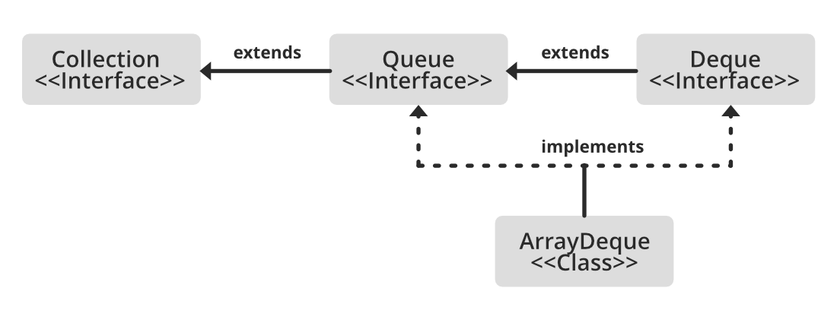

Slide 7
Array Deque implements : Queue and Deque.
It is dynamically resizable from both sides.
All implemented interfaces of Array Deque in the hierarchy are Serializable, Cloneable, Iterable<E>, Collection<E>,Deque<E>, Queue<E>.

Slide 8
Syntax: Declaration
public class ArrayDeque<E>
extends AbstractCollection<E>
implements Deque<E>, Cloneable, Serializable
Here, E refers to the element which can refer to any class,
such as Integer or String class.

Slide 9
constructors
ArrayDeque()
ArrayDeque<E> dq = new ArrayDeque<E>();
ArrayDeque(Collection<? extends E> c)
ArrayDeque<E> dq = new ArrayDeque<E>(Collection col);
ArrayDeque(int numofElements)
ArrayDeque<E> dq = new ArrayDeque<E>(int numofElements);

Slide 10
various operations on the Array Deque
Adding operation
Accessing operation
Removing operations
Iterating through the Deque

Slide 11
Operation 1: Adding Elements
add()
addFirst()
addLast()
Offer()
offerFirst()
offerLast()

Slide 12
Operation 2: Accessing the Elements
getFirst()
getLast()
peek()
peekFirst()
peekLast()

Slide 13
Operation 3. Removing Elements
Remove from both the ends
remove()
removeFirst()
removeLast()
Apart from that
poll()
pollFirst()
pollLast()
pop()

Slide 14
Operation 4: Iterating through the Deque
remove()
iterator()
descendingIterator()

Slide 15
ARRAY DEQUE AS A STACK
To implement LIFO stacks in JAVA.
Faster
Methods for implementing stack.
push()-adds an element to the top of the stack.
Peek()-returns an element from the top of the stack.
Pop()-returns and removes an element from the top of the stack.

